Slide 1
Data Exploration and Visualization
Data Mining for Business Analytics in R
Shmueli, Bruce, Yahav, Patel & Lichtendahl
Notes:
Describe basic plots and distribution plots
How different visualizations and operations help data mining tasks
Some guidelines on specific visualizations for specific tasks
Specialized plots for specialized data
Specialized plots suitable for data with special structure (hierarchical, network, and geographical)
Picture is worth a thousand words.
Primarily used in preprocessing portion of the data mining process.
Finding incorrect values, missing values, duplicate rows, columns with same value, etc.
Variable selection – which ones to include and which might be redundant
Determining bin sizes. Is binning needed for numerical variables?
Combine categories?
Managing data collection costs by determining which ones to get, after using visualization methods.
Not an exhaustive visualization discussion. Limited to how visualization supports subsequent data mining goals.

Slide 2
Graphs for Data Exploration
Basic Plots
Line Graphs
Bar Charts
Scatterplots
Distribution Plots
Boxplots
Histograms
Notes:
Graphical exploration can support free-form exploration for the purpose of understanding the data structure, cleaning the data (e.g., identifying unexpected gaps or “illegal” values), identifying outliers, discovering initial patterns (e.g., correlations among variables and surprising clusters), and generating interesting questions.
Base R vs. ggplot.
Learning ggplot involvs a non-trivial learning curve. Good investment of time though, if used regularly.
Examples in base R and ggplot.
Ggplot. GG refers to “Grammar of Graphics”.
To illustrate data visualization, several datasets are used, including these:
Boston Housing Data: Potential tasks: i) predict MEDV, ii) classification CAT.MEDV, iii) Clustering
Ridership on Amtrack Trains

Slide 3
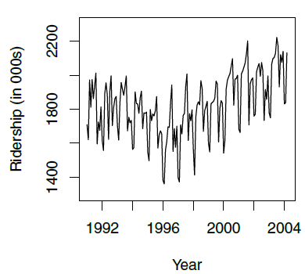
Line Graph for Time Series Amtrak Ridership
# use time series analysis
library(forecast)
ridership.ts <- ts(Amtrak.df$Ridership, start = c(1991, 1), end = c(2004, 3), freq = 12)
plot(ridership.ts, xlab = "Year", ylab = "Ridership (in 000s)", ylim = c(1300, 2300))
Notes:
Trend: The trend component represents the long-term movement or direction in the time series. It indicates whether the time series is generally increasing, decreasing, or stable over time. Trends can be linear (constant slope) or nonlinear (changing slope).
Seasonality: The seasonality component captures regular patterns that repeat at fixed intervals within the time series. These intervals are typically shorter than the overall time span of the data. Seasonal patterns can be daily, weekly, monthly, quarterly, or yearly, depending on the data and context.
Cyclic Patterns: Cyclic patterns are long-term oscillations or fluctuations in the time series that are not tied to fixed calendar-based intervals. Unlike seasonality, cyclic patterns do not have a fixed duration. They are often related to economic, business, or environmental cycles and can last for several years.
Irregular or Residual Component: The irregular component, also known as the residual component, represents the random or unexplained variation in the time series. It includes all the factors that cannot be attributed to trend, seasonality, or cyclic patterns. Irregularities can result from various unpredictable events and noise in the data.
Level: The level of the time series refers to the average or baseline value around which the data fluctuates. It is a constant term that represents the central tendency of the data and can be considered a component, especially in time series decomposition models.
Used in multiple domains very heavily.
Finance and Economics: Stock market forecasting, economic forecasting like GDP, unemployment, inflation, etc.
Retail and E-Commerce: Sales forecasting, inventory management, customer behavior analysis
Energy and Utilities: Electricity demand forecasting, oil & gas production
Weather and Climate science: Weather forecasting, climate change analysis

Slide 4
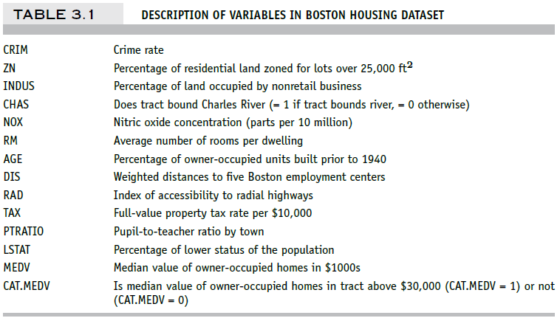
Boston Housing – Data Dictionary
Notes:
three possible tasks:
1. supervised predictive task, where the outcome variable of interest is the median value of a home in the tract (MEDV).
2. supervised classification task, where the outcome variable of interest is the binary variable CAT.MEDV that indicates whether the home value is above or below $30,000.
3. unsupervised task, where the goal is to cluster census tracts.

Slide 5
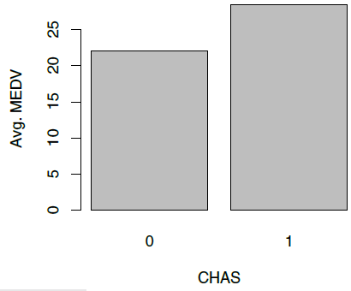
Bar Chart for Numerical Variable Average median value for neighborhoods that do and do not border the Charles River
## barchart of CHAS vs. mean MEDV
# compute mean MEDV per CHAS = (0, 1)
data.for.plot <- aggregate(housing.df$MEDV, by = list(housing.df$CHAS), FUN = mean)
names(data.for.plot) <- c("CHAS", "MeanMEDV")
barplot(data.for.plot$MeanMEDV, names.arg = data.for.plot$CHAS,
xlab = "CHAS", ylab = "Avg. MEDV")
Notes:
This is useful in the early stages of getting familiar with the data structure, the amount and types of variables, the volume and type of missing values, etc.
Bar charts are useful for comparing a single statistic (e.g., average, count, percentage) across groups. The height of the bar (or length in a horizontal display) represents the value of the statistic, and different bars correspond to different groups.

Slide 6
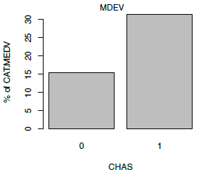
Bar Chart for Categorical Variable Percentage of tracts with CAT.MEDV =1 that do and do not border the Charles River
## barchart of CHAS vs. % CAT.MEDV
data.for.plot <- aggregate(housing.df$CAT..MEDV, by = list(housing.df$CHAS), FUN = mean)
names(data.for.plot) <- c("CHAS", "MeanCATMEDV")
barplot(data.for.plot$MeanCATMEDV * 100, names.arg = data.for.plot$CHAS,
xlab = "CHAS", ylab = "% of CAT.MEDV")
Notes:
This is useful in the early stages of getting familiar with the data structure, the amount and types of variables, the volume and type of missing values, etc.
Bar charts are useful for comparing a single statistic (e.g., average, count, percentage) across groups. The height of the bar (or length in a horizontal display) represents the value of the statistic, and different bars correspond to different groups.

Slide 7
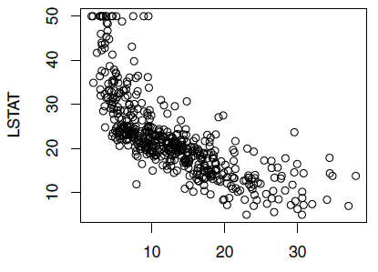
Scatterplot Displays relationship between two numerical variables
MEDV
## scatter plot with axes names
plot(housing.df$MEDV ~ housing.df$LSTAT, xlab = "MDEV", ylab = "LSTAT")
Notes:
The nature of the data mining task and domain knowledge about the data will affect the use of basic charts in terms of the amount of time and effort allocated to different variables. In supervised learning, there will be more focus on the outcome variable. In scatter plots, the outcome variable is typically associated with the y-axis. In unsupervised learning (for the purpose of data reduction or clustering), basic plots that convey relationships (such as scatter plots) are preferred.
Useful for prediction and clustering.

Slide 8
Distribution Plots
Display “how many” of each value occur in a data set
Or, for continuous data or data with many possible values, “how many” values are in each of a series of ranges or “bins”
Notes:
The boxplot and the histogram are two plots that display the entire distribution of a numerical variable. Although averages are very popular and useful summary statistics, there is usually much to be gained by looking at additional statistics such as the median and standard deviation of a variable, and even more so by examining the entire distribution.

Slide 9
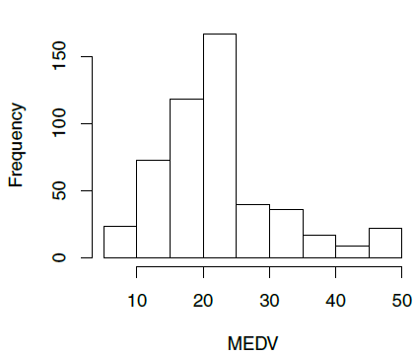
Histograms
Boston Housing example:
Histogram shows the distribution of the outcome variable (median house value)
About 40 neighborhoods had a median house value < $10,000 (these data are from mid-20th century)
## histogram of MEDV
hist(housing.df$MEDV, xlab = "MEDV")

Slide 10
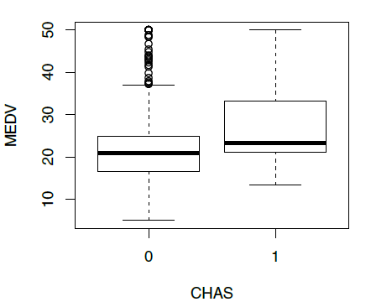
Boxplots
Side-by-side boxplots are useful for comparing subgroups
Houses in neighborhoods on Charles river (1) are more valuable than those not (0)
## boxplot of MEDV for different values of CHAS
boxplot(housing.df$MEDV ~ housing.df$CHAS, xlab = "CHAS", ylab = "MEDV")
Notes:
Box: The central rectangle or "box" in the plot represents the interquartile range (IQR), which contains the middle 50% of the data. The box is divided into two parts: the lower quartile (Q1) and the upper quartile (Q3). Q1 is the 25th percentile, and Q3 is the 75th percentile of the data. The length of the box represents the range between Q1 and Q3.
Median (Q2): The line inside the box represents the median (Q2) of the dataset, which is the middle value when the data is sorted. It divides the data into two equal halves.
Whiskers: The "whiskers" extend from the box to the minimum and maximum values within a defined range. The range is typically calculated as 1.5 times the IQR. Any data points beyond this range are considered outliers and are often plotted as individual points or asterisks.
Outliers: Individual data points that fall outside the whiskers are displayed as individual points or asterisks and are considered potential outliers. Outliers are values that significantly differ from the bulk of the data and may be important for further investigation.
Notch: Some boxplots include a "notch" on either side of the box. The notches provide a rough indication of the uncertainty around the median. If the notches of two boxplots do not overlap, it suggests that there is strong evidence that the medians of the two groups differ.
Interpreting a boxplot:
Central Tendency: The median is a measure of central tendency, and it gives you an idea of the middle value of the data. If the median is close to the center of the box, it indicates that the data is approximately symmetrically distributed.
Spread: The length of the box (IQR) indicates the spread of the middle 50% of the data. A longer box suggests greater variability in the data, while a shorter box suggests less variability.
Skewness: If the median is not centered in the box and is closer to one of the quartiles, it suggests that the data may be skewed in that direction.
Outliers: The presence of individual points or asterisks outside the whiskers indicates potential outliers or extreme values in the data.

Slide 11
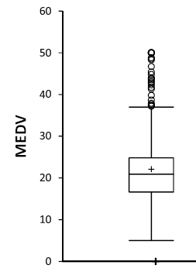
Box Plot
Top outliers defined as those above Q3+1.5(Q3-Q1).
“max” = maximum of non-outliers
Analogous definitions for bottom outliers and for “min”
Details may differ across software
outliers
“max”
Quartile 3
Median
Quartile 1
“min”

Slide 12
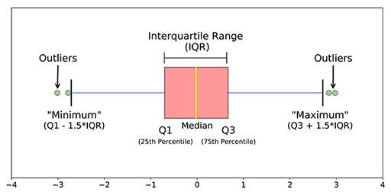
Box Plot
Median (Q2/50th Percentile): the middle value of the dataset.
First quartile (Q1/25th Percentile): the middle number between the smallest number (not the “minimum”) and the median of the dataset.
Third quartile (Q3/75th Percentile): the middle value between the median and the highest value (not the “maximum”) of the dataset.
InterQuartile Range (IQR): 25th to the 75th percentile. IQR tells how spread the middle values are.
“maximum”: Q3 + 1.5*IQR
“minimum”: Q1 -1.5*IQR
Outliers: (shown as green circles) In statistics, an outlier is an observation point that is distant from other observations.

Slide 13
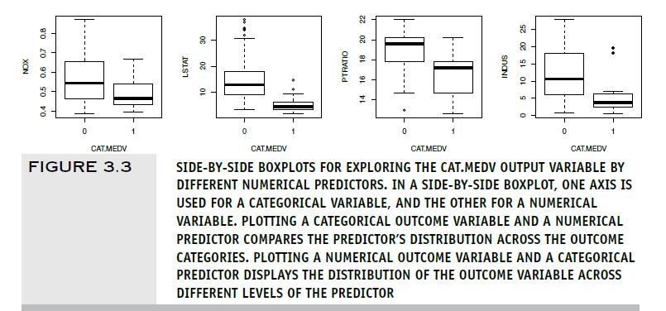
Side by Side Box Plots
Notes:
side-by-side boxplots are useful in classification tasks for evaluating the potential of numerical predictors. This is done by using the x-axis for the categorical outcome and the y-axis for a numerical predictor. An example is shown in Figure 3.3, where we can see the effects of four numerical predictors on CAT.MEDV. The pairs that are most separated (e.g., PTRATIO and INDUS) indicate potentially useful predictors.

Slide 14
Heat Maps
Color conveys information
In data mining, used to visualize
Correlations
Missing Data

Slide 15
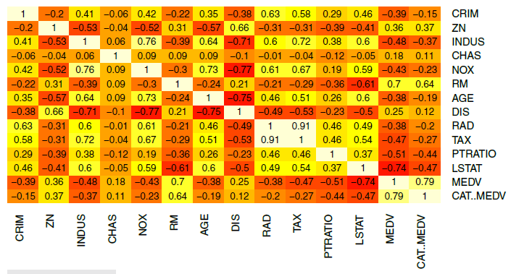
Heatmap to highlight correlations Darker & redder = more negative correlation
Lighter and yellower = more positive correlation
## simple heatmap of correlations (without values)
heatmap(cor(housing.df), Rowv = NA, Colv = NA)
## heatmap with values
library(gplots)
heatmap.2(cor(housing.df), Rowv = FALSE, Colv = FALSE, dendrogram = "none",
cellnote = round(cor(housing.df),2),
notecol = "black", key = FALSE, trace = 'none', margins = c(10,10))
Notes:
A heatmap is a graphical display of numerical data where color is used to denote values. In a data mining context, heatmaps are especially useful for two purposes: for visualizing correlation tables and for visualizing missing values in the data.
cor(housing.df):
This calculates the correlation matrix of the housing.df dataset, which is then used as the input for the heatmap. Each cell in the heatmap represents the correlation between two variables in the dataset.
Rowv = FALSE and Colv = FALSE:
These arguments specify whether to reorder the rows (Rowv) and columns (Colv) based on the hierarchical clustering order. Setting both to FALSE means that the rows and columns are not reordered, and the variables will appear in the order they are in the dataset.
dendrogram = "none":
This argument controls whether dendrograms (which show the hierarchical clustering of the rows and columns) are drawn. "none" indicates that no dendrograms are shown.
cellnote = round(cor(housing.df), 2):
This argument allows you to add text annotations inside each cell of the heatmap. Here, it is used to display the correlation values rounded to two decimal places.
notecol = "black":
This sets the color of the text annotations (the correlation values) to black.
key = FALSE:
The color key, which usually shows the scale of the correlation values, is not displayed in this heatmap.
trace = 'none':
This argument disables the trace lines, which can be used to highlight certain aspects of the data matrix. In this case, no trace lines are drawn.
margins = c(10, 10):
This sets the size of the margins around the heatmap to ensure that the row and column names are fully visible. The first value corresponds to the bottom margin (for column names), and the second value corresponds to the left margin (for row names).

Slide 16
Missing Values Heatmap
Notes:
In a missing value heatmap, rows correspond to records and columns to variables. We use a binary coding of the original dataset where 1 denotes a
missing value and 0 otherwise. This new binary table is then colored such that only missing value cells (with value 1) are colored. Figure 3.5 shows an example
of a missing value heatmap for a dataset with over 1000 columns. The data include economic, social, political, and “well-being” information on different
countries around the world (each row is a country). The variables were merged from multiple sources, and for each source information was not always available
on every country. The missing data heatmap helps visualize the level and amount of “missingness” in the merged data file. Some patterns of “missingness” easily
emerge: variables that are missing for nearly all observations, as well as clusters of rows (countries) that are missing many values. Variables with little missingness
are also visible. This information can then be used for determining how to handle the missingness (e.g., dropping some variables, dropping some records,
imputing, or via other techniques).

Slide 17
Multidimensional Visualization
Notes:
Adding Variables: Color, Size, Shape, Multiple Panels, and Animation
Basic plots can convey richer information with features such as color, size, and multiple panels, and by enabling operations such as rescaling, aggregation, and
interactivity. These additions allow looking at more than one or two variables at a time. The beauty of these additions is their effectiveness in displaying complex
information in an easily understandable way.
To represent additional categorical information, the best way is to use hue, shape, or multiple panels.
For additional numerical information, we can use color intensity or size.
Temporal information can be added via animation.

Slide 18
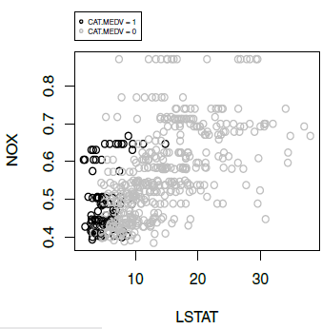
Scatterplot with color/shade added
Boston Housing
NOX vs. LSTAT
light shade = low median value
dark shade = high median value
# alternative plot with ggplot [text has more complex Base R coding too]
library(ggplot2)
ggplot(housing.df, aes(y = NOX, x = LSTAT, colour= CAT..MEDV)) +
geom_point(alpha = 0.6)

Slide 19
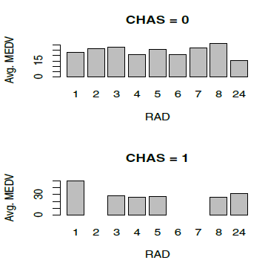
Bar chart for MEDV vs. RAD, first for low-value neighborhoods, then for high value neighborhoods
data.for.plot <- aggregate(housing.df$MEDV, by = list(housing.df$RAD,
housing.df$CHAS),FUN = mean, drop = FALSE)
ggplot(data.for.plot) +
geom_bar(aes(x = as.factor(RAD), y = `meanMEDV`), stat = "identity") +
xlab("RAD") + facet_grid(CHAS ~ .)
see Fig. 3.6 for more
Notes:
Creating multiple panels (also called “trellising”) is done by splitting the observations according to a categorical variable, and creating a separate plot (of the same type) for each category.

Slide 20
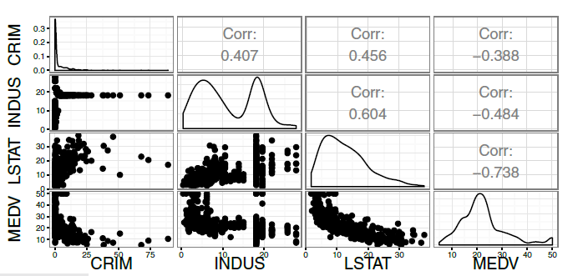
Matrix Scatterplot
Diagonal plot is the frequency distribution for the variable
## simple plot
# use plot() to generate a matrix of 4X4 panels with variable name on the diagonal,
# and scatter plots in the remaining panels.
plot(housing.df[, c(1, 3, 12, 13)])
# alternative, nicer plot (displayed)
library(GGally)
ggpairs(housing.df[, c(1, 3, 12, 13)])
Notes:
It ranges from -1 to 1, where:-1 indicates a perfect negative linear relationship (as one variable increases, the other decreases linearly).
1 indicates a perfect positive linear relationship (as one variable increases, the other increases linearly).
0 indicates no linear relationship.

Slide 21
Manipulation:
Rescaling
Aggregation
Zooming
Filtering
Notes:
Most of the time spent in data mining projects is spent in preprocessing. Typically, considerable effort is expended getting all the data in a format that can actually
be used in the data mining software. Additional time is spent processing the data in ways that improve the performance of the data mining procedures. This
preprocessing step in data mining includes variable transformation and derivation of new variables to help models perform more effectively. Transformations
include changing the numeric scale of a variable, binning numerical variables, and condensing categories in categorical variables.

Slide 22
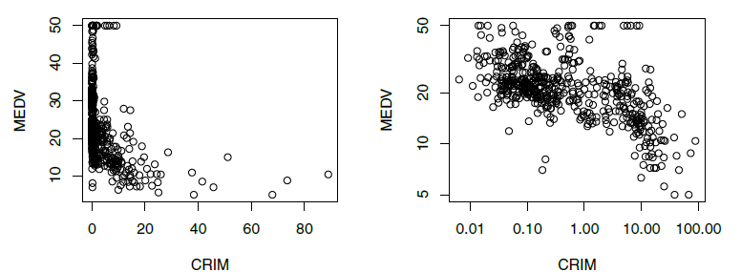
Rescaling to log scale (on right) “uncrowds” the data
## scatter plot: regular and log scale
plot(housing.df$MEDV ~ housing.df$CRIM, xlab = "CRIM", ylab = "MEDV")
# to use logarithmic scale set argument log = to either 'x', 'y', or 'xy'.
plot(housing.df$MEDV ~ housing.df$CRIM,
xlab = "CRIM", ylab = "MEDV", log = 'xy')

Slide 23
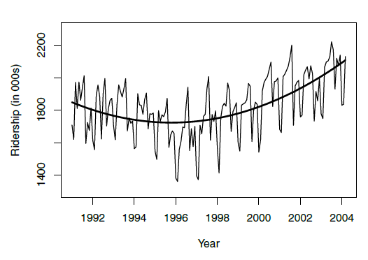
Amtrak Ridership – Monthly Data – Curve Added
## fit curve
ridership.lm <- tslm(ridership.ts ~ trend + I(trend^2))
plot(ridership.ts, xlab = "Year", ylab = "Ridership (in 000s)", ylim =
c(1300, 2300))
lines(ridership.lm$fitted, lwd = 2)
Notes:
The function tslm() from the forecast package in R stands for Time Series Linear Model. It is an extension of the base lm() function used for fitting linear regression models but is specifically designed to handle time series data.

Slide 24
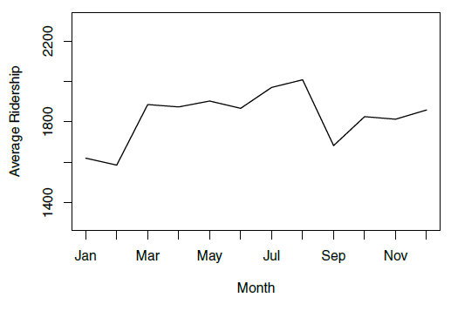
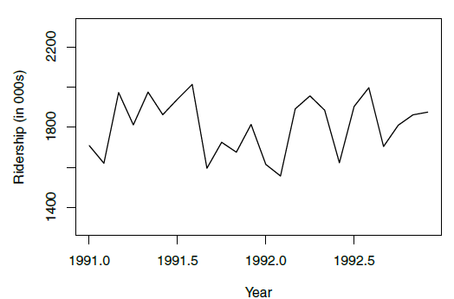
Amtrak Ridership
Monthly Average
Zoom in
## zoom in, monthly, and annual plots
ridership.2yrs <- window(ridership.ts, start = c(1991,1), end = c(1992,12))
plot(ridership.2yrs, xlab = "Year", ylab = "Ridership (in 000s)", ylim = c(1300, 2300))
monthly.ridership.ts <- tapply(ridership.ts, cycle(ridership.ts), mean)
plot(monthly.ridership.ts, xlab = "Month", ylab = "Average Ridership",
ylim = c(1300, 2300), type = "l", xaxt = 'n')
## set x labels
axis(1, at = c(1:12), labels = c("Jan","Feb","Mar", "Apr","May","Jun",
"Jul","Aug","Sep", "Oct","Nov","Dec"))
annual.ridership.ts <- aggregate(ridership.ts, FUN = mean)
plot(annual.ridership.ts, xlab = "Year", ylab = "Average Ridership",
ylim = c(1300, 2300))
Notes:
Aggregation by month on the left.
Aggregation of temporal scale can be of different granularity (e.g., monthly, daily, hourly) or even by a “seasonal” factor of interest such as month-of-year or day-of-week.
Non-temporal variables can be aggregated if some meaningful hierarchy exists: geographical (tracts within a zip code in the Boston Housing example), organizational, etc.

Slide 25
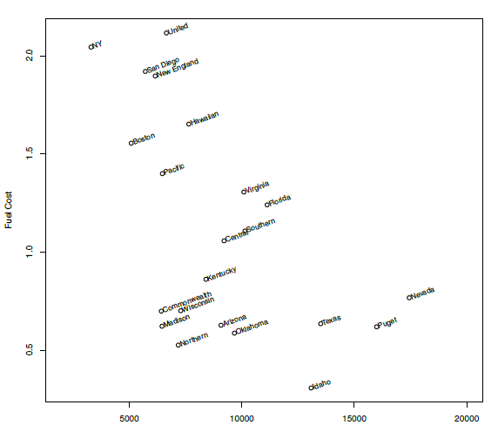
Scatter Plot with Labels (Utilities)
plot(utilities.df$Fuel_Cost ~ utilities.df$Sales,
xlab = "Sales", ylab = "Fuel Cost", xlim = c(2000, 20000))
text(x = utilities.df$Sales, y = utilities.df$Fuel_Cost,
labels = utilities.df$Company, pos = 4, cex = 0.8, srt = 20, offset = 0.2)
Notes:
In displays that are not overcrowded, the use of in-plot labels can be useful for better exploration of outliers and clusters.
The figure shows different utilities on a scatter plot that compares fuel cost with total sales. We might be interested in clustering the data, and using clustering algorithms to identify clusters that differ markedly with respect to fuel cost and sales.
Will be using this dataset when we learn Clustering.

Slide 26
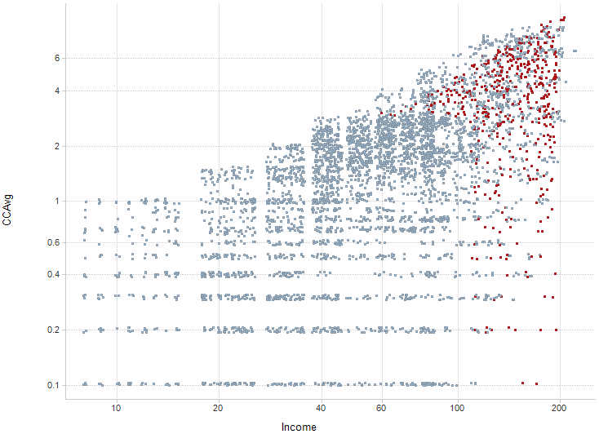
Scaling: Smaller markers, jittering, color contrast (Universal Bank; red = accept loan)
Jitter = add noise to “unstack” markers that hide markers underneath
# use function alpha() in library scales to add transparent colors
library(scales)
plot(jitter(universal.df$CCAvg, 1) ~ jitter(universal.df$Income, 1),
col = alpha(ifelse(universal.df$Securities.Account == 0, “gray", “red"), 0.4),
pch = 20, log = 'xy', ylim = c(0.1, 10),
xlab = "Income", ylab = "CCAvg")
Notes:
Scaling up to Large Datasets
When the number of observations (rows) is large, plots that display each individual observation (e.g., scatter plots) can become ineffective. Aside from using aggregated charts such as boxplots, some alternatives are:
1. Sampling—drawing a random sample and using it for plotting
2. Reducing marker size
3. Using more transparent marker colors and removing fill
4. Breaking down the data into subsets (e.g., by creating multiple panels)
5. Using aggregation (e.g., bubble plots where size corresponds to number of observations in a certain range)
6. Using jittering (slightly moving each marker by adding a small amount of noise)

Slide 27
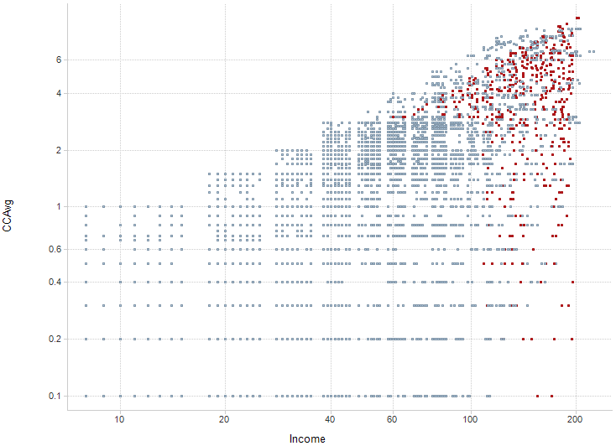
Without jittering
With jittering

Slide 28
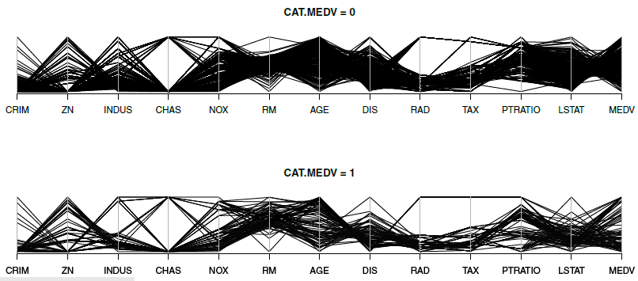
Parallel Coordinate Plot (Boston Housing)
All variables are rescaled to 0-1 scale
Each line is a single record
library(MASS)
par(mfcol = c(2,1))
parcoord(housing.df[housing.df$CAT..MEDV == 0, -14], main = "CAT.MEDV = 0")
parcoord(housing.df[housing.df$CAT..MEDV == 1, -14], main = "CAT.MEDV = 1")
Notes:
We see that the more expensive homes (bottom panel) consistently have low CRIM, low LSAT, and high RM compared to cheaper homes (top panel), which are more mixed on CRIM, and LSAT, and have a medium level of RM. This observation gives indication of useful predictors.
Parallel coordinates plots are also useful in unsupervised tasks. They can reveal clusters, outliers, and information overlap across variables. A useful manipulation is to reorder the columns to better reveal observation clusterings.
NOX (Nitric Oxides Concentration):
In the plot for CAT.MEDV = 0, there is a greater spread and higher NOX values overall, indicating that houses with lower median values tend to be located in areas with higher nitric oxide concentration.
For CAT.MEDV = 1, the lines are more concentrated towards lower NOX values, suggesting that houses with higher median values are likely located in areas with lower pollution.
Rooms (RM):
There’s a noticeable difference in the number of rooms (RM). For CAT.MEDV = 1 (higher value), houses tend to have more rooms (greater RM values). In contrast, houses in CAT.MEDV = 0 have fewer rooms.
This is a strong indicator that the number of rooms is positively correlated with house value.
LSTAT (Lower Status of the Population):
For CAT.MEDV = 0, LSTAT (proportion of lower-income population) is generally higher, showing that houses in lower-value areas tend to be in neighborhoods with a higher percentage of lower-income residents.
For CAT.MEDV = 1, LSTAT values are lower, implying that higher-value houses are located in more affluent neighborhoods.

Slide 29
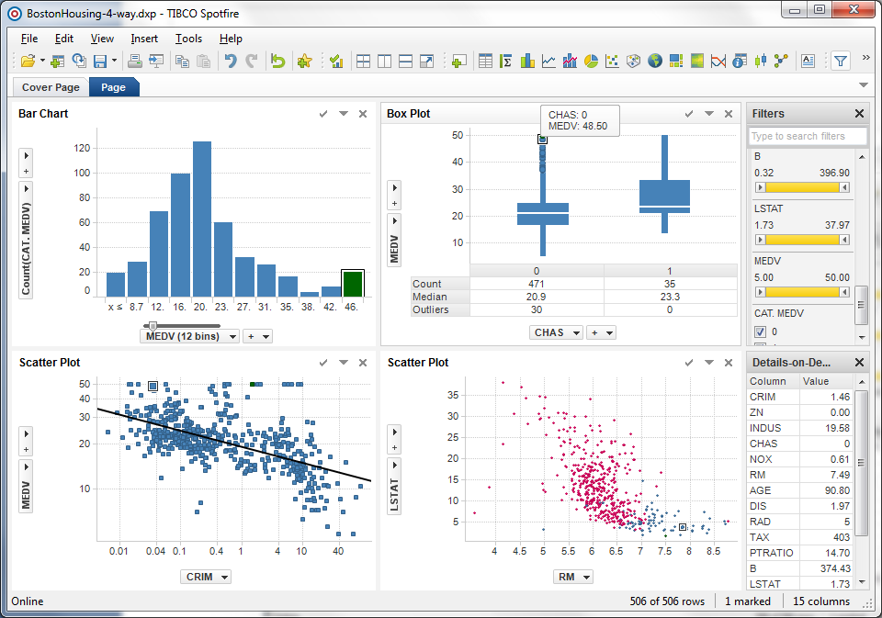
Linked plots (same record is highlighted in each plot)
Produced in Spotfire

Slide 30
Specialized Visualiztions:
Networked Data
Hierarchical Data: Treemaps
Geographical Data: Map Charts

Slide 31
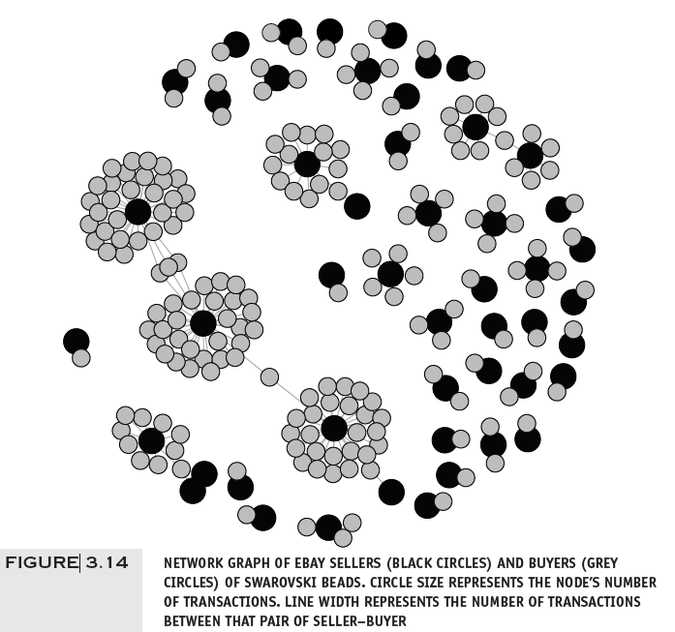
Network Graph eBay Auctions
library(igraph)
ebay.df <- read.csv("eBayNetwork.csv")
# transform node ids to factors
ebay.df[,1] <- as.factor(ebay.df[,1])
ebay.df[,2] <- as.factor(ebay.df[,2])
graph.edges <- as.matrix(ebay.df[,1:2])
g <- graph.edgelist(graph.edges, directed = FALSE)
isBuyer <- V(g)$name %in% graph.edges[,2]
plot(g, vertex.label = NA, vertex.color = ifelse(isBuyer, "gray", "black"),
vertex.size = ifelse(isBuyer, 7, 10))

Slide 32
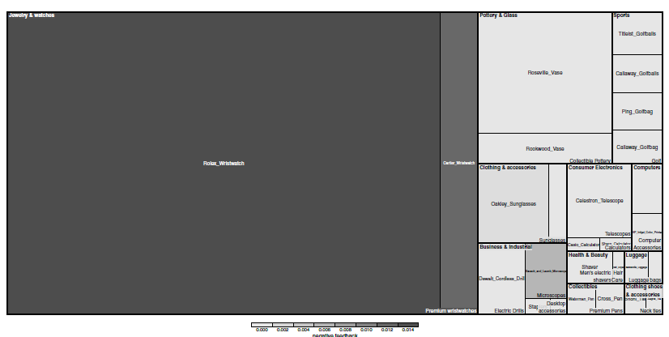
Treemap – eBay Auctions (Hierarchical eBay data: Category> sub-category> Brand)
Detail on this corner – next slide
library(treemap)
tree.df <- read.csv("EbayTreemap.csv")
# add column for negative feedback
tree.df$negative.feedback <- 1* (tree.df$Seller.Feedback < 0)
# draw treemap
treemap(tree.df, index = c("Category","Sub.Category", "Brand"),
vSize = "High.Bid", vColor = "negative.feedback", fun.aggregate = "mean",
align.labels = list(c("left", "top"), c("right", "bottom"), c("center", "center")),
palette = rev(gray.colors(3)), type = "manual", title = "")
Notes:
Treemaps are useful visualizations specialized for exploring large data sets that are hierarchically structured (treestructured). They allow exploration of various dimensions of the data while
maintaining the hierarchical nature of the data.
Arguments of treemap()
index = c("Category", "Sub.Category", "Brand"):
Specifies the hierarchical structure of the treemap.
The treemap will first group data by Category, then by Sub.Category, and finally by Brand. Each rectangle (and subrectangle) represents a specific category, subcategory, or brand in the dataset.
vSize = "High.Bid":
Determines the size of the rectangles in the treemap.
The size of each rectangle is proportional to the High.Bid variable, which likely represents the highest bid amount for a product in that category or subcategory.
vColor = "negative.feedback":
Specifies the coloring scheme for the rectangles based on the negative.feedback column.
The color of the rectangles will depend on the presence of negative feedback (1 for negative, 0 for non-negative).
fun.aggregate = "mean":
If there are multiple entries for the same category, subcategory, or brand, this argument specifies that the mean value of the High.Bid or negative.feedback should be used when aggregating the data.
align.labels = list(c("left", "top"), c("right", "bottom"), c("center", "center")):
This argument aligns the labels within each rectangle.
The alignment for labels is specified as left and top for the outer rectangles, right and bottom for the next level, and center for the innermost level.
palette = rev(gray.colors(3)):
Specifies the color palette for the treemap.
gray.colors(3) creates a color scale with 3 shades of gray, and rev() reverses the order, so the darkest gray corresponds to the highest value of negative.feedback.
type = "manual":
This indicates that a custom color scale is being used rather than a predefined one.
title = "":
Removes the title from the plot, leaving it blank.

Slide 33
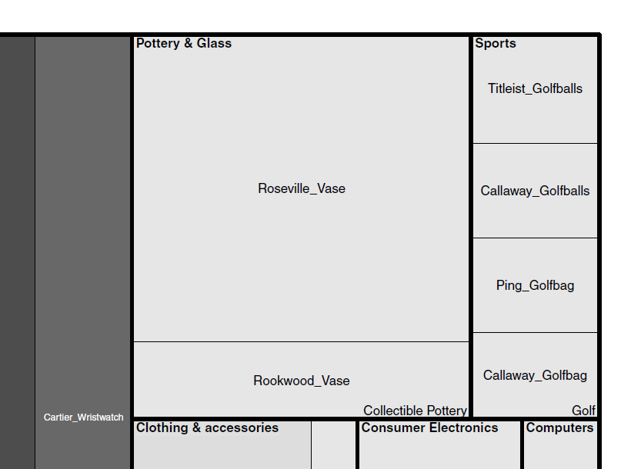
Category
Brand
Rectangle size = avg. value of item
Subcategory
Darker = more negative feedback
Notes:
A large set of auctions from eBay.com, hierarchically ordered by item category, sub-category, and brand.
Size of the rectangle is used to represent the average closing price (which reflects item value) and color intensity represents the percent of sellers with negative feedback (a negative seller feedback indicates buyer dissatisfaction in past transactions and is often indicative of fraudulent seller behavior).

Slide 34
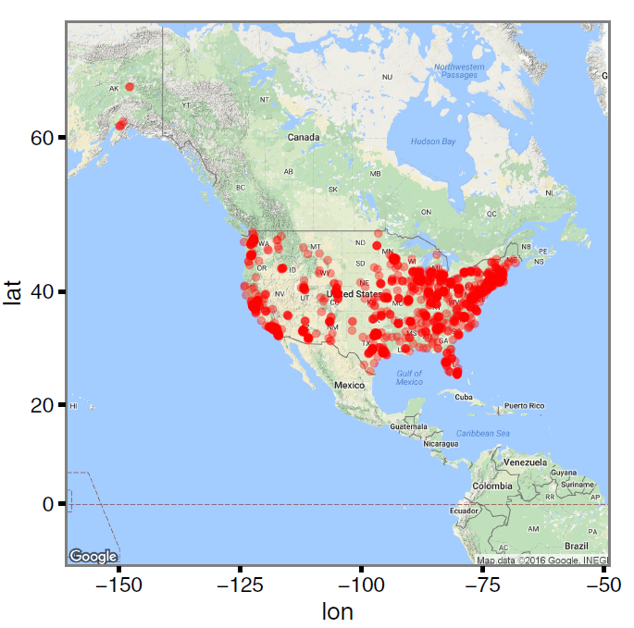
Using Google Maps
Location of Statistics.com students and instructors
library(ggmap)
SCstudents <- read.csv("SC-US-students-GPS-data-2016.csv")
Map <- get_map("Denver, CO", zoom = 3)
ggmap(Map) + geom_point(aes(x = longitude, y = latitude), data = SCstudents,
alpha = 0.4, colour = "red", size = 0.5)
Notes:
Need google api key to generate the map.

Slide 35
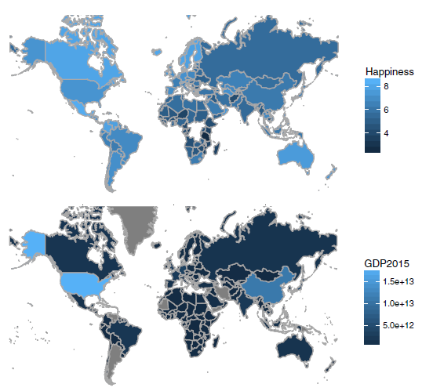
Map Chart
(Comparing countries’ well-being with GDP)
Darker = higher value
library(mosaic)
gdp.df <- read.csv("gdp.csv", skip = 4, stringsAsFactors = FALSE)
names(gdp.df)[5] <- "GDP2015"
happiness.df <- read.csv("Veerhoven.csv")
# gdp map
mWorldMap(gdp.df, key = "Country.Name", fill = "GDP2015") + coord_map()
# well-being map
mWorldMap(happiness.df, key = "Nation", fill = "Score") + coord_map() +
scale_fill_continuous(name = "Happiness")

Slide 36
Appendix

Slide 37
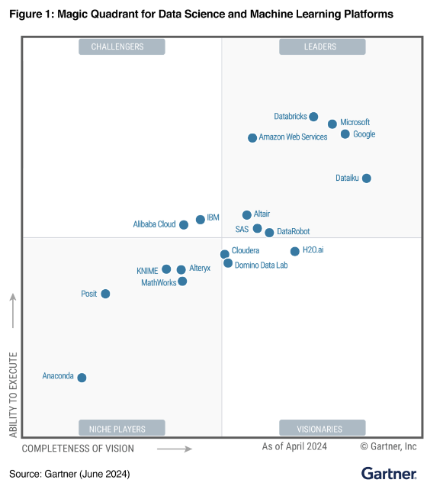

Slide 38
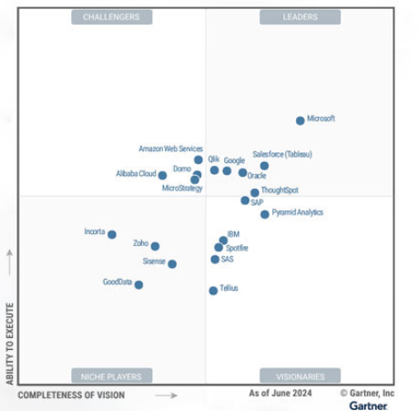
Magic Quardrant for Analytics and Business Intelligence (ABI)

